Slide 1

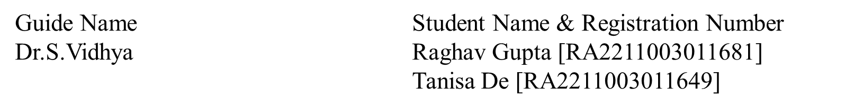
Review 1 GlowSprig Project Category: RESEARCH

Slide 2
Abstract
The project aims to create a virtual platform for natural skincare using herbal plants. The system leverages facial recognition to classify skin types and recommends suitable herbal treatments. It integrates AI-driven skin analysis and chatbot assistance to provide personalized, sustainable skincare solutions, bridging traditional herbal knowledge with modern technology. The platform also includes a virtual herbal garden, allowing users to explore plants and their skincare benefits.

Slide 3
Introduction
Natural skincare solutions often lack personalization and accessibility.
This project addresses the gap by creating a virtual platform for natural skincare.
Uses herbal / medicinal plants and AI-driven skin analysis.
Features include a skin analyzer and chatbot for personalized recommendations.
Aims to make natural skincare sustainable, user-friendly, and tailored to individual needs.

Slide 4
Literature Survey
S. No | Title | Methodology | Identification of gaps and limitations.
1 | Khalid, M., Jubbair, M., Gupta, M., Singh, S. P., & Kumar, A. (2025). Herbal harmony: Fusing tradition and modernity in skincare. High Technology Letters, 31(1). https://doi.org/10.37896/HTL31.1/11911 | Herbal ingredients like neem, aloe vera, and turmeric have antibacterial and anti-inflammatory benefits. Combines traditional herbs with modern skincare for better stability and efficacy. Highlights growing consumer demand for herbal skincare over synthetic products. | Lacks large-scale clinical trials for diverse skin validation. Does not focus on region-specific herbal formulations. No strategies to improve consumer trust in herbal skincare.
2 | Sirawit Saiwaeo , Sujitra Arwatchananukul, Lapatrada Mungmai , Weeraya Preedalikit , Nattapol Aunsri (2023.)Human skin type classification using image processing and deep learning approaches. https://www.sciencedirect.com/science/article/pii/S2405844023083846?via%3Dihub | Develop skin analysis, recommendation engine, and UI. Integrate herbal garden with region-based plant data. Implement chatbot, multilingual support, and e-commerce. Conduct testing, data collection, and AI model training. | Dataset Imbalance Bias in Image Quality Feature Overlap Limited Generalization Loss Rate -21.68% No mention of model performance in real-world conditions.

Slide 5
Limitations ( Research Gaps)
Lack of comprehensive data on region-specific herbal plants – Existing research primarily focuses on general herbal skincare, but there is limited information on herbs specific to different regions and their effectiveness for various skin concerns.
Challenges in user adoption due to trust issues – Many users prefer commercial skincare products over herbal alternatives due to a lack of awareness, scientific validation, and concerns about effectiveness.
Need for better AI models for accurate skin analysis – Current AI-based skin classification models face challenges in accuracy, particularly for diverse skin types, and require more robust datasets and algorithms.

Slide 6
Research objectives
Develop an AI-powered tool for skin analysis and personalized herbal skincare – Implement advanced techniques to accurately determine skin type and suggest suitable herbal solutions.
Create an interactive platform integrating herbal knowledge and modern technology – Combine AI-driven recommendations, chatbot assistance, and an easy-to-use interface to enhance user engagement and learning.
Promote sustainable and eco-friendly skincare solutions – Focus on the use of natural, locally available herbal ingredients while ensuring sustainability in sourcing and product packaging.

Slide 7
Product Backlogs- Researcher Perspective
Extract and process data on herbal plants and skin types – Gather scientific data on herbs, preprocess skin images for AI training, and build a structured knowledge base for recommendations.
Develop AI/ML models and chatbot for personalized skin care guidance – Train machine learning models for skin type classification and implement a chatbot for real-time user interaction and product suggestions.
Design a user-friendly platform with real-time recommendations – Develop a responsive web application that seamlessly integrates skin analysis, herbal skincare advice, and chatbot assistance.

Slide 8
Technique to implement the objectives
Use AI & ML for skin analysis and personalized recommendations – Implement convolutional neural networks (CNN) for skin classification, optimize models using transfer learning, and enhance accuracy with diverse datasets.
Implement NLP-based chatbot for user interaction – Utilize advanced natural language processing (NLP) techniques to build a chatbot capable of answering skincare queries and providing personalized herbal suggestions.
Develop a scalable and accessible web platform – Use modern web technologies for a smooth user experience, ensuring the platform is accessible on different devices while maintaining performance and reliability.

Slide 9
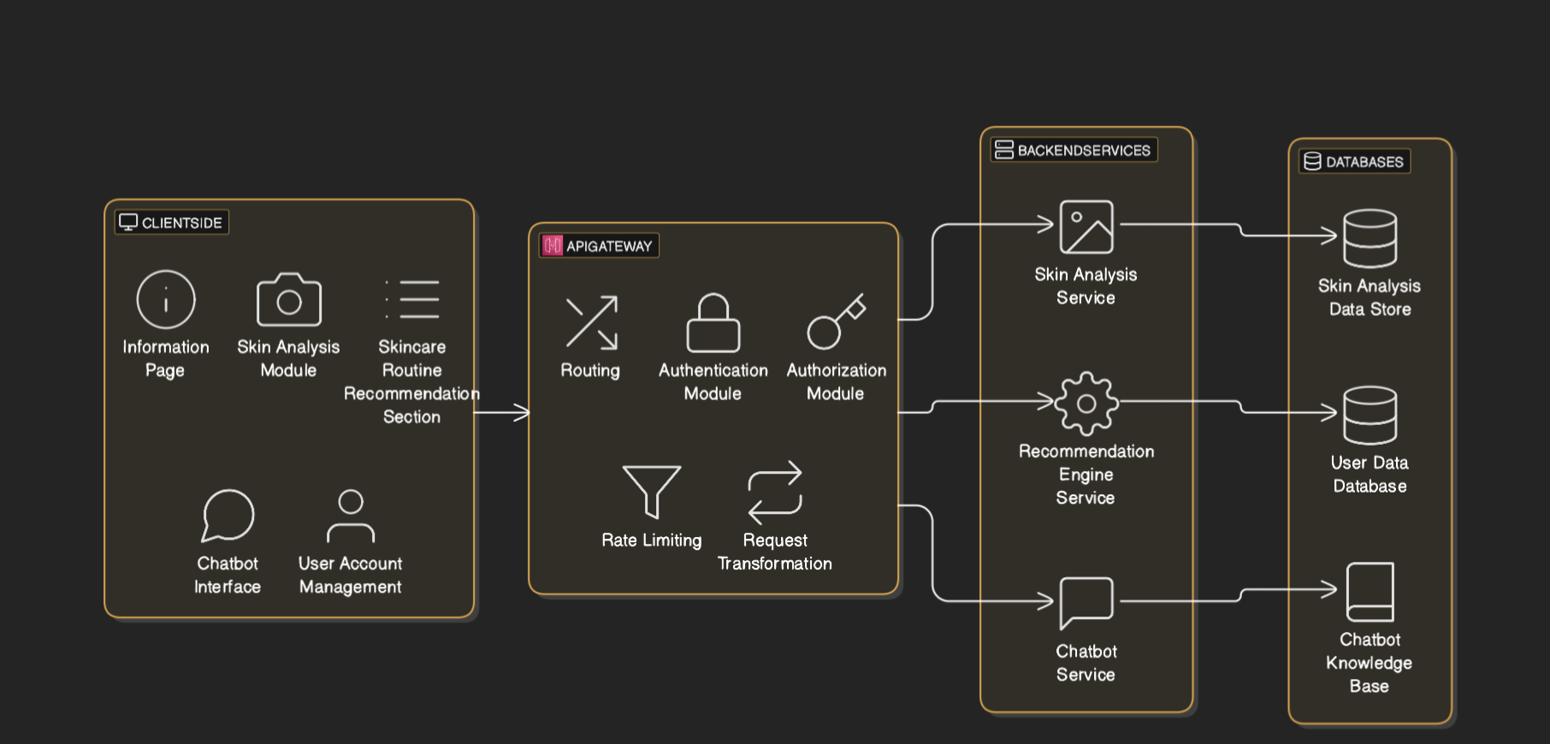
System Architecture

Slide 10
Project SDG
Holistic Health (SDG 3):
Integrates herbal skincare for overall well-being.
Empowering Knowledge: Provides skin health & routine information for user management.
Affordable Skin care Access: Delivers accessible and localized skin knowledge, recommendations via apps.
Proactive Prevention: Early skin analysis for preventing potential issues, and tracking via scientific approaches.
Culturally Sensitive Remedies: Skin customization to match to distinct dermatological cases and ethnic regions in deployment patterns to improve local implementation efficacy.
Less Chemical Dependency: Creates alternatives that enable local economic empowerment opportunities from decreased conventionalized practices.

Slide 11
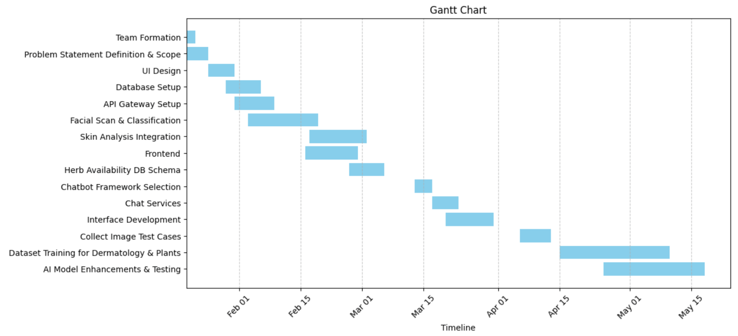
Plan of action (Timeline)

Slide 12
References
Antal DS, Avram Ș, Heinrich M. Editorial: Skin: benefits of natural products in topical applications. Front Pharmacol. 2023 Nov 10;14:1305705. doi: 10.3389/fphar.2023.1305705. PMID: 38026951; PMCID: PMC10667924.
Singh, P.A., Dash, S., Choudhury, A. et al. Factors affecting long-term availability of medicinal plants in India. J. Crop Sci. Biotechnol. 27, 145–173 (2024). https://doi.org/10.1007/s12892-023-00219-y
Sara Dassouli, Harit Satt, Nissrine Senhaji ,International Journal of Pharmaceutical and Healthcare Marketing- Attitude and behavior towards chatbots: case of the beauty care industry
ISSN: 2663-2187, B. Lokesh, Assistant Professor, MGIT Anjali Devarakonda, UG Student, MGIT G Srinivas, UG Student, MGIT Nitish Kumar Naik, UG Student, MGIT, African Journal of Biological Sciences- INTELLIGENT FACIAL SKIN CARE RECOMMENDATION SYSTEM

Slide 13
Thank You

